Slide 1







SMART KRISHI
Modern Tools Ancient Farming
PROJECT ID : 2DS_MP05_2024
DOMAIN : AGRICULTURE
SHAN SHARMA
SHIVAM MISHRA
SATYAM YADAV
SAURAV CHAUDHARY
PROJECT CO-ORDINATOR: RamPal Singh

Slide 2







INDEX
ABSTRACT
PROBLEM STATEMENT
SOLUTION OVERVIEW
MONITORING
DESIGN
FLOWCHART
CIRCUIT DIAGRAM
SOIL HEALTH MONITORING
CROP PATTERN OPTIMIZATION
AUTOMATED WATER AND FERTILIZER MANAGEMENT
DATA-DRIVEN INSIGHTS FOR DECISION MAKING
COMMUNITY ENGAGEMENT AND EDUCATIONAL RESOURCES
CASE STUDY
FUTURE SCOPE
CONCLUSION
REFERENCES

Slide 3





ABSTRACT
The project focuses on automating irrigation to optimize water usage using an Arduino Uno R3 microcontroller.
Key components include:
Soil moisture sensor: Monitors real-time soil moisture levels.
Temperature and humidity sensor (e.g., DHT11/DHT22): Tracks environmental conditions.
Relay module and water pump: Controls water flow based on sensor data.
Working principle:
The system activates the water pump when soil moisture levels drop below a predefined threshold.
It stops irrigation once optimal moisture levels are restored, conserving water.
Optional enhancements include IoT integration for remote monitoring and control via a mobile app or web interface.

Slide 4





Problem Statement
Indian farmers, who make up about 42% of the workforce, face substantial challenges in optimizing crop yields and managing resources effectively. Despite their vast experience, many lack formal education and a business-oriented mindset, which limits their ability to adopt modern agricultural practices. Over 70% of farmers are smallholders, struggling to earn a decent income. This situation is further aggravated by the absence of real-time data analysis for soil health monitoring and resource management. Tragically, between 2014 and 2020, over 55,000 farmers committed suicide, often due to debt and crop failure, highlighting the urgent need for technology-driven solutions to support these farmers.

Slide 5
Solution Overview
Smart Farming System:
Designed to address challenges faced by Indian farmers.
Enhances productivity and profitability through innovative technology.
Key Features:
Data-Driven Insights:
Provides actionable recommendations for crop selection and resource allocation.
Automation:
Automates irrigation and fertilization processes based on real-time data.
Real-Time Monitoring:
Uses IoT sensors for continuous monitoring of soil health and environmental conditions.

Slide 6

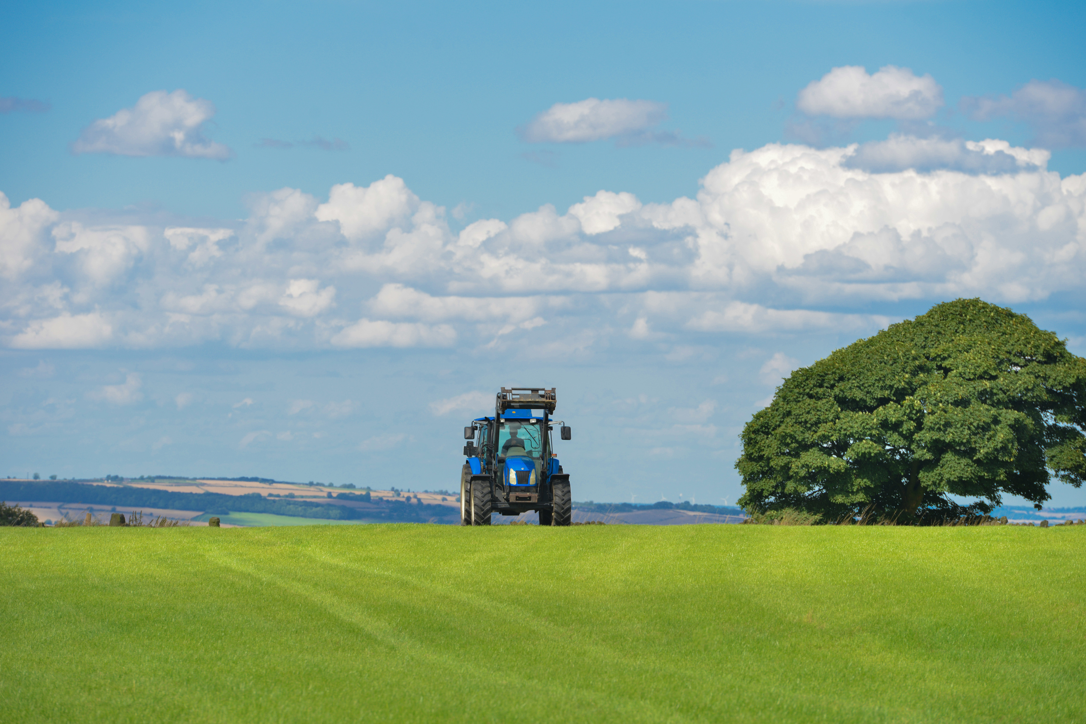
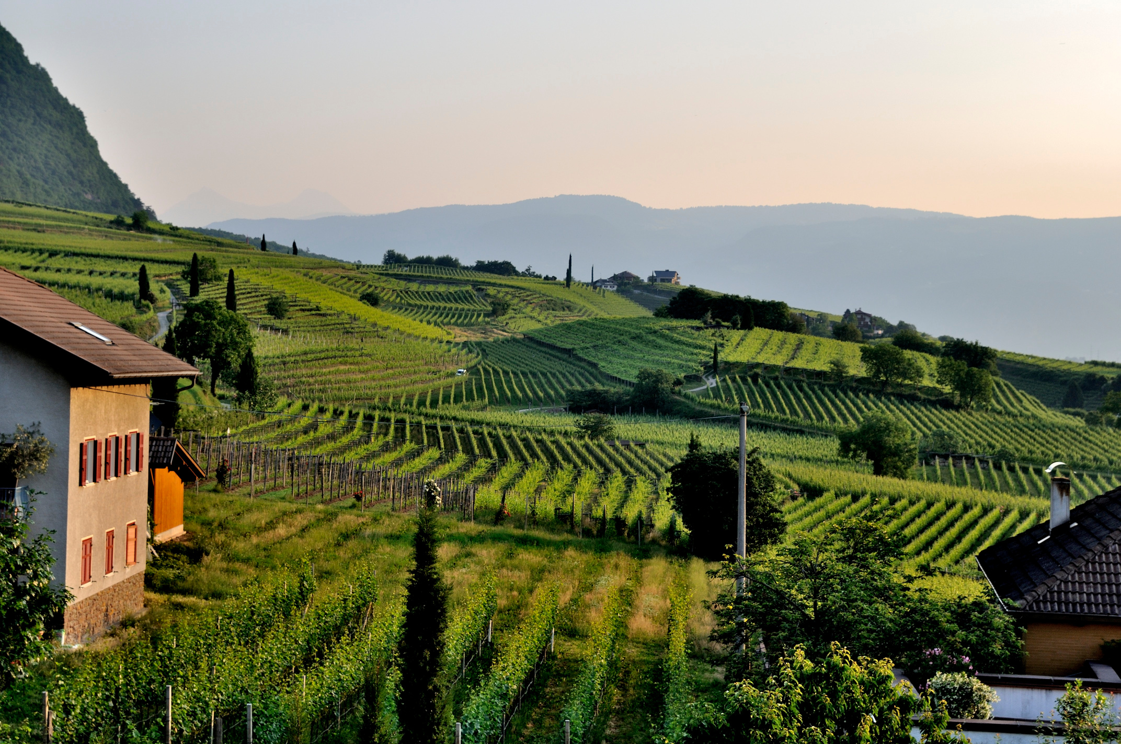
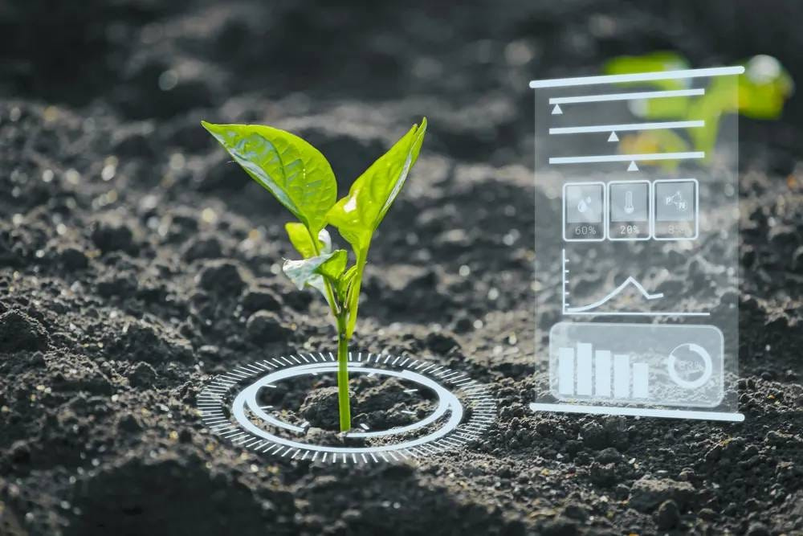
Real-Time Soil Monitoring
Sensors installed in various locations to gather data on:
Moisture levels
Nutrient content
pH levels
Provides real-time insights into soil health
Helps farmers understand soil conditions and make informed decisions
Ensures crops receive the right amount of water and nutrients based on current soil needs

Slide 7
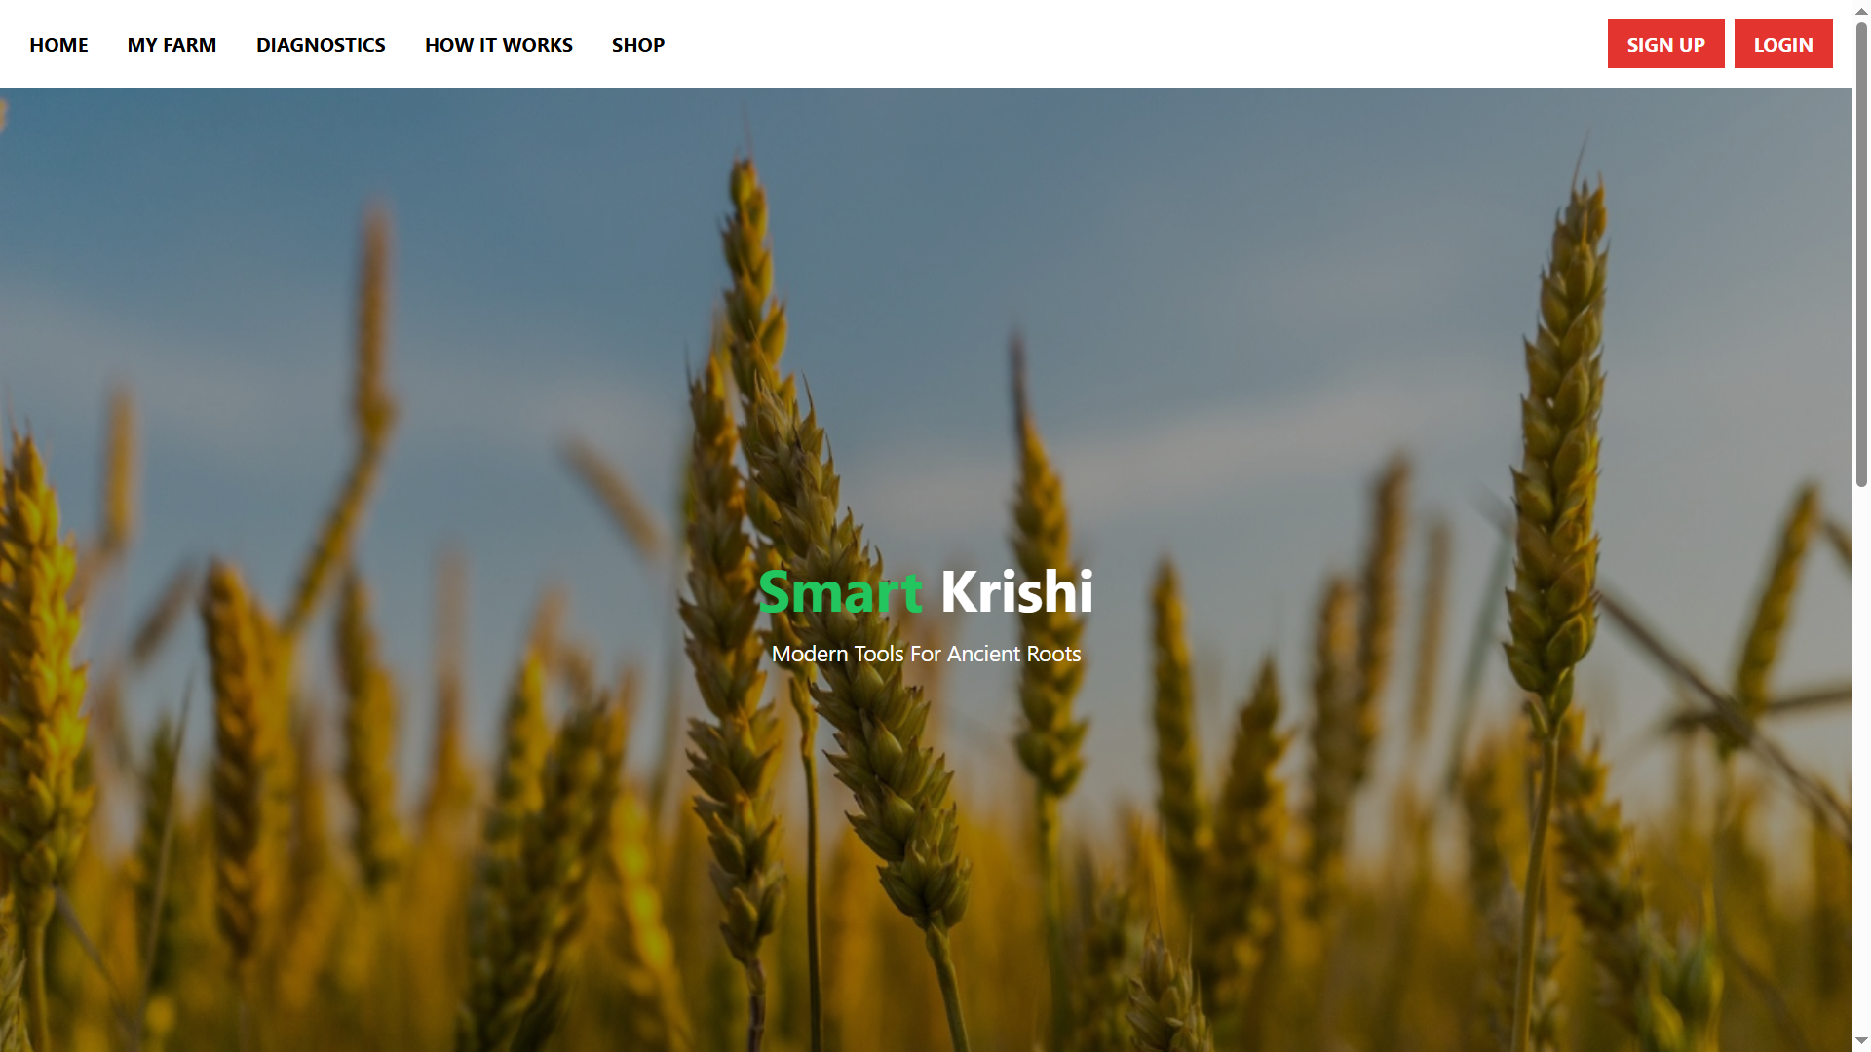
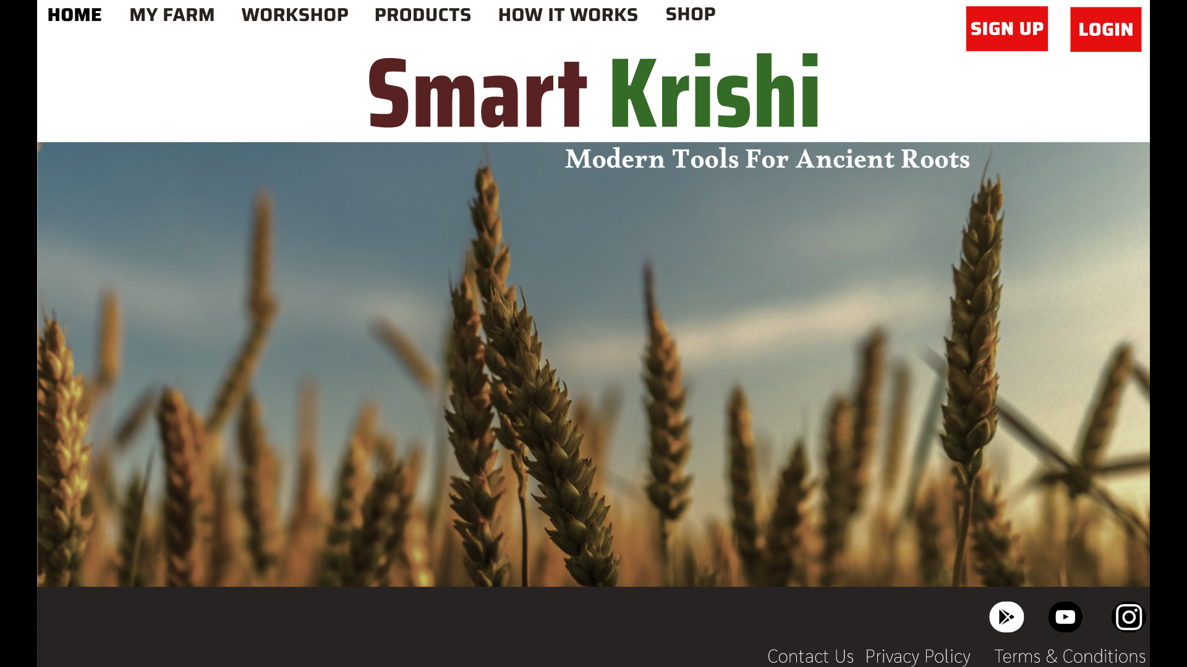

Slide 8
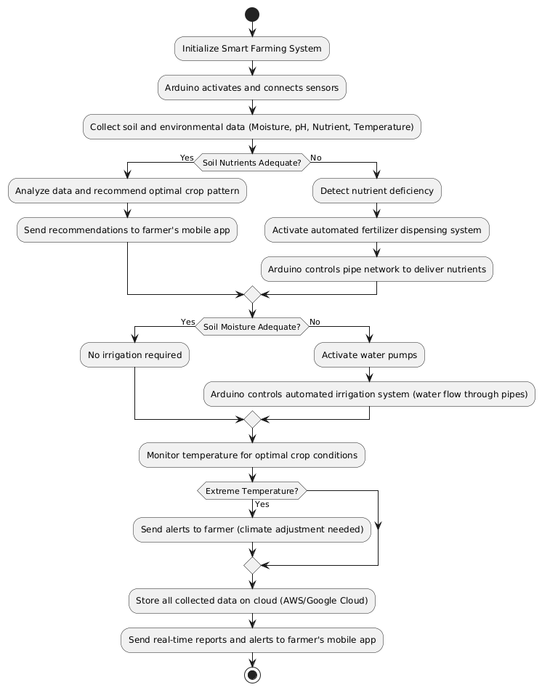
FLOWCHART

Slide 9
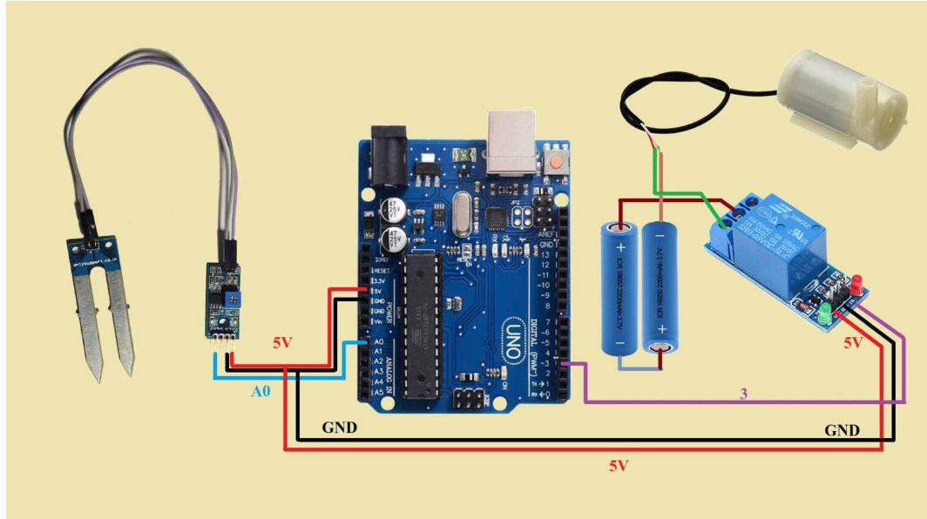

Slide 10
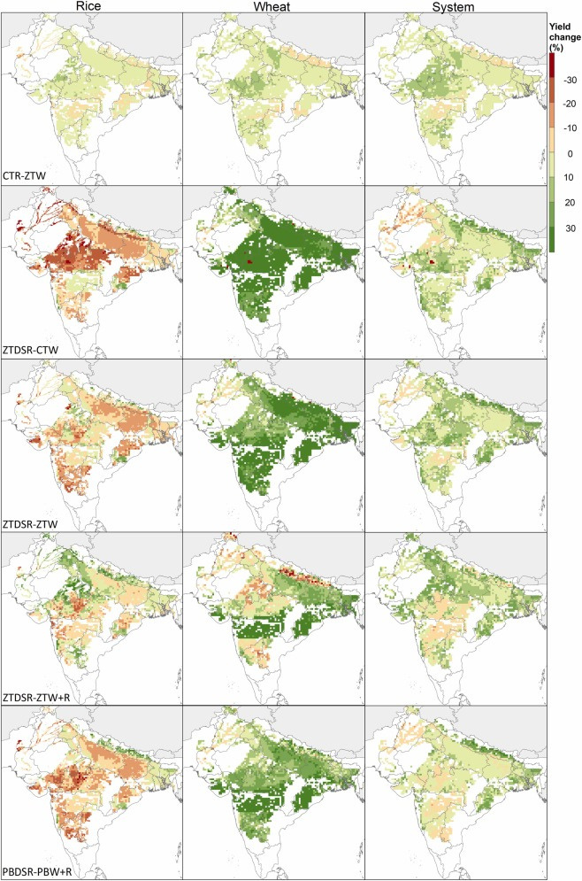
CROP PATTERN OPTIMIZATION
Data Collection:
Real-time data from soil sensors is aggregated and stored
Algorithmic Analysis:
Advanced algorithms analyze the collected data to identify trends and patterns
Determines optimal planting times and crop combinations
Crop Recommendations:
Recommends the best crop patterns based on soil conditions and historical data
Suggests ideal ratios for planting multiple crops to enhance yield and profitability

Slide 11
Automated Water and Fertilizer Management
Automation Technology:
Utilizes sensors and IoT devices to automate irrigation and fertilizer applications.
Real-Time Soil Data:
Adjusts water and fertilizer delivery based on current soil conditions and needs.
Precision Resource Use:
Ensures optimal application rates to match crop requirements, reducing waste.
Cost Efficiency:
Lowers labor costs by minimizing manual intervention and optimizing resource usage.
Environmental Impact:
Reduces runoff and pollution, promoting sustainable farming practices.

Slide 12
Data-Driven Insights for Decision Making
Utilization of Analytics:
Leverages data analysis to generate actionable insights tailored for farmers.
Forecasting Capabilities:
Provides forecasts on market trends, crop performance, and weather conditions.
Informed Decision Making:
Empowers farmers to make better financial choices regarding investments and resource allocation.
Operational Efficiency:
Helps streamline farming operations by identifying best practices and optimizing resource use.
Risk Management:
Equips farmers with information to mitigate risks associated with crop failure and market volatility.

Slide 13
Community Engagement and Educational Resources
Knowledge Sharing Platform:
A space for farmers to exchange experiences, tips, and best practices.
Training Modules:
Comprehensive courses on modern agricultural practices and financial literacy.
Resource Accessibility:
Easy access to instructional materials, videos, and guides to enhance farming techniques.
Feedback Loop:
Encourages user input to continuously improve the solution based on farmer needs.

Slide 14
OVERALL
BENEFITS
Increased Crop Yields
Resource Efficiency
Farmer Empowerment
Data-Driven Decisions:
Real-time soil data helps farmers optimize crop selection and planting schedules.
Precision Farming:
Automated irrigation and fertilization ensure crops receive the exact amount of water and nutrients needed, preventing undernourishment or overuse.
Smart Irrigation:
Water is applied based on real-time moisture data, preventing over- or under-watering and conserving water resources.
Sustainable Practices:
By avoiding resource overuse, the system promotes long-term soil health and helps maintain sustainable farming practices.
Access to Real-Time Data:
Farmers receive continuous updates on soil conditions, crop health, and resource needs, enabling timely and informed decisions.
Educational Resources:
Offers guidance on sustainable farming techniques, helping farmers adopt best practices and improve efficiency.

Slide 15
CASE STUDY
Nutrient Deficiency and Crop Failures in India
In parts of India, farmers face crop failures due to nutrient-deficient soil. Without accurate soil data, they either under-apply or over-apply fertilizers, leading to poor crop growth and environmental harm. A smart agriculture system, through real-time nutrient monitoring, provides precise fertilization recommendations, improving both soil health and crop productivity while reducing fertilizer waste.
Crop Damage Due to Climate Change (Australia)
Unpredictable weather patterns, such as floods or droughts, cause significant crop losses.Smart agriculture can use weather data and predictive analytics to help farmers prepare for climate extremes, adjusting crop planting times and irrigation schedules accordingly.

Slide 16
Future Scope
Complete Package Sales:
Offer a comprehensive smart farming solution that includes hardware, software, and ongoing support.
Subscription Model:
Implement a subscription-based service for continuous access to features, updates, and educational resources.
Continuous Data Tracking:
Regularly collect and analyze user data to enhance AI models and improve recommendations.
Expansion to Diverse Regions:
Adapt and scale the system for various agricultural practices across India and internationally.

Slide 17
Conclusion
Recap: Summarize the key aspects of the Smart Farming Solution, focusing on the integration of real-time data, automation, and education for farmers.
Impact on Farmers:
Boosts Productivity: Ensures efficient use of resources like water and fertilizers, optimizing crop yield.
Increases Income: Recommends profitable crop patterns and reduces input costs.
Improves Well-Being: Eases workload, empowers farmers with knowledge, and fosters a sustainable farming approach.
Call to Action: Highlight the next steps for implementation or adoption of the solution.

Slide 18






REFERENCES
Case Study on Smart Irrigation in India – Published by ICAR (Indian Council of Agricultural Research). (08/09/2024 12:12)
AI and Automation in Agriculture – World Economic Forum Reports, 2022.Government and Policy Documents. (08/11/2024 12:12)
USDA Reports on Precision Agriculture – United States Department of Agriculture. (23/11/2024 19:10)
Precision Agriculture Technologies and Applications by John V. Stafford.(BOOK)
The Future of Farming: Technology and Innovation by Robert Blair.(BOOK)
FAO Website (www.fao.org) for global agricultural data and solutions. (09/11/2024 13:12)
ICAR Website (www.icar.org.in) for Indian agriculture advancements. (09/12/2024 17:12)

